Slide 1
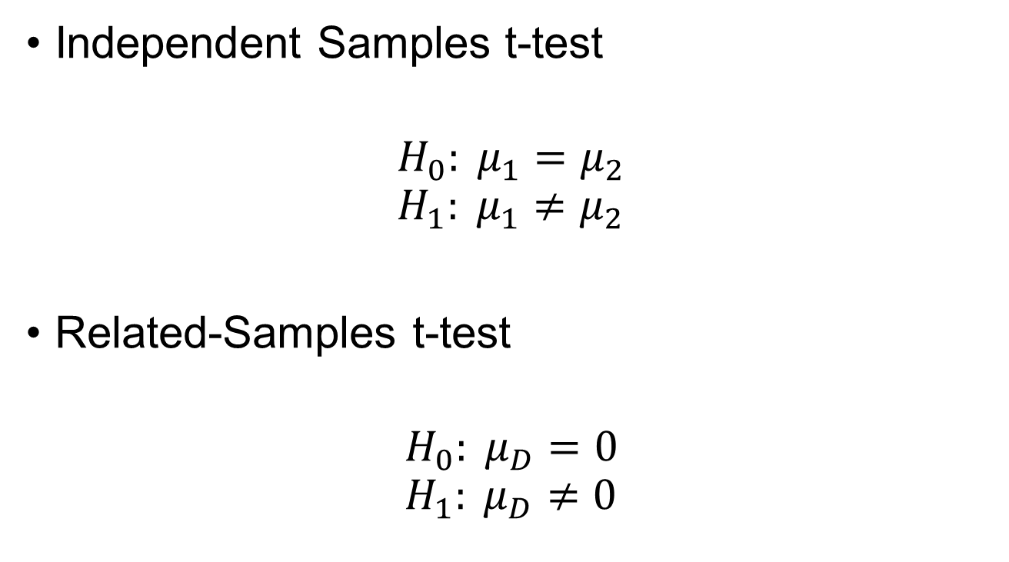
Hypotheses
Independent Samples t-test
$$H_{0}: μ_{1}=μ_{2} \\ H_{1}: μ_{1}≠μ_{2}$$
Related-Samples t-test
$$H_{0}: μ_{D}=0 \\ H_{1}: μ_{D}≠0$$

Slide 2

Independent Samples t-test
$$t=\frac{{(M}_{1}−M_{2})−(μ_{1}−μ_{2})}{\sqrt{{s_{1}^{2}}/{n_{1}}+{s_{2}^{2}}/{n_{2}}}}$$
Notes:
T-stat for unequal variances (we won’t be working with this in this class)

Slide 3

Independent Samples t-test pooled sample variance
$$s_{p}^{2}=\frac{\left(n_{1}−1\right)s_{1}^{2}+\left(n_{2}−1\right)s_{2}^{2}}{n_{1}+n_{2}−2}$$
Notes:
Pooled variance (under homogeneity of variance assumption) = weighted average of the two sample variances

Slide 4


Independent Samples t-test using pooled variance
$$t=\frac{(M_{1}−M_{2})−(μ_{1}−μ_{2})}{\sqrt{{s_{p}^{2}}/{n_{1}}+{s_{p}^{2}}/{n_{2}}}}$$
$$df=n_{1}+n_{2}−2$$
Notes:
T-stat under HOV assumption; now this follows a t-distribution

Slide 5

Effect Size for Independent Samples t-test
$$d=\frac{M_{1}−M_{2}}{\sqrt{s_{p}^{2}}}$$
$$η^{2}=\frac{t^{2}}{t^{2}+df} or ω^{2}=\frac{t^{2}−1}{t^{2}+df}$$
Notes:
Measures of effect size; d (cohen’s d), n2 (eta squared), w2 (omega squared)

Slide 6


Related-Samples t-test
$$t=\frac{\overline{D}−0}{{s_{D}}/{\sqrt{n}}}$$
$$df=n −1$$

Slide 7

Effect Size for Related-Samples t-test
$$d=\frac{\overline{D}−μ_{D}}{s_{D}}$$
$$η^{2}=\frac{t^{2}}{t^{2}+df} or ω^{2}=\frac{t^{2}−1}{t^{2}+df}$$

